Slide 1
NSC-R Tidy Tuesdays
Every other week
Online
Open to all
Fundamental skills
Diverse datasets
Repetative
Less structured

Slide 2
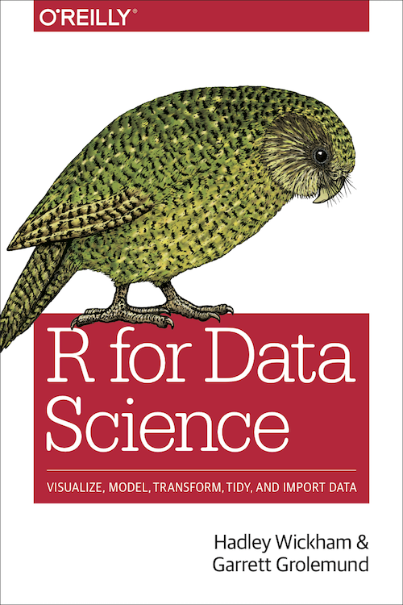

Inspirations
https://www.tidytuesday.com/
https://r4ds.had.co.nz
https://www.rfordatasci.com/

Slide 3
Sports data
Incredible amount of data on sports (some free)
Various units of analysis
competitions (e.g. UK Premier League football) and tournaments (e.g. Wimbledon tennis)
matches, e.g. Chelsea vs. Arsenal, Nadal vs. Djokovic
teams, e.g. Manchester City, Real Madrid
players, e.g. Hakim Zyech, Roger Federer
events, e.g. passes, goals, fouls, free kicks in football
Sports data science is a master study (e.g. in Leiden, Delft)

